Slide 1
A Step to Realtime Stock & Commodities Monitoring System

Slide 2
A Step to Realtime Stock & Commodities Monitoring System
My investment policy lean towards Value Investor. However, Including the short-term Technical Analysis technique into my planning may increase my profit.
My plan is to
Buy multiple “SELECTED” stock
Whenever short-term technical analysis technique suggest that I should increase some stock → Sell other stock to buy this stock
Also, apply “Sell at Peak” when possible
Background

Slide 3
A Step to Realtime Stock & Commodities Monitoring System
As my programming skill is still relatively low. I am unable to finished full program on time. So, I use this project to create a steppingstone for full program
Short-Term Objective
Create a trustworthy, reliable and profitable program to do the technical analysis on stock & commodities to alert and suggest the transaction
Even in full version, I may not utilize fully algorithmic trading on my entire portfolio
Long-Term Objective

Slide 4
A Step to Realtime Stock & Commodities Monitoring System
Current Version
Expected Full Version
2 years Historical data of 12 Nasdaq defense industry stock with 1 Minute interval
Input
1 Minutes streaming of realtime data
of stock and commodities
Graph
CSV
Indicator analyzing
Alert pop-up window
Alert line chatbot
Output
Raw influxdb’s graph
CSV

Slide 5
Current Process
Scraping Historical Data
Stream data to influxdb
Scraping Raw Data
Covert raw data to proper format
Combine data from each months

Slide 6

Scraping Historical Data
Stream data to influxdb
Current Process
Scraping Raw Data
Covert raw data to proper format
Combine data from each months
https://www.alphavantage.co/

Slide 7
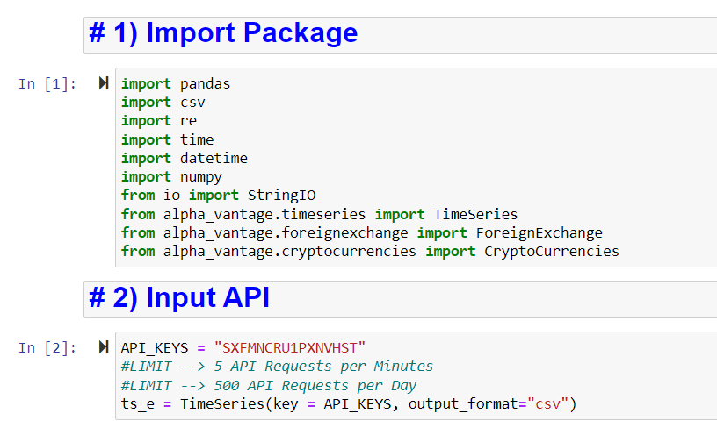
Scraping Historical Data
Stream data to influxdb
Current Process
Scraping Raw Data
Covert raw data to proper format
Combine data from each months

Slide 8
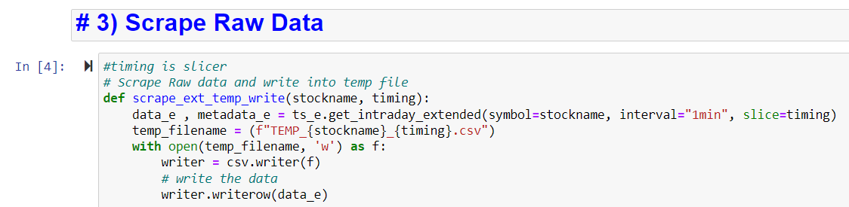
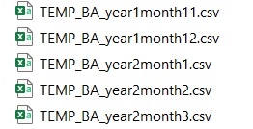
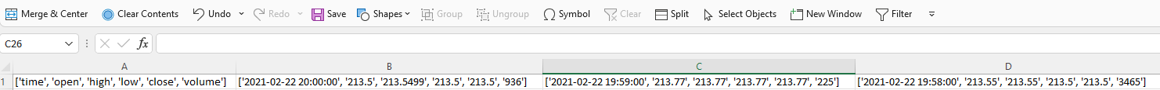
Scraping Historical Data
Stream data to influxdb
Current Process
Scraping Raw Data
Covert raw data to proper format
Combine data from each months

Slide 9
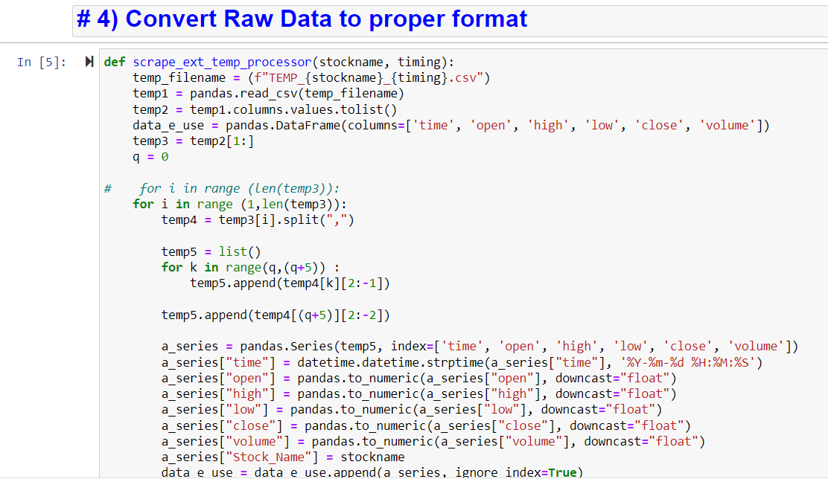
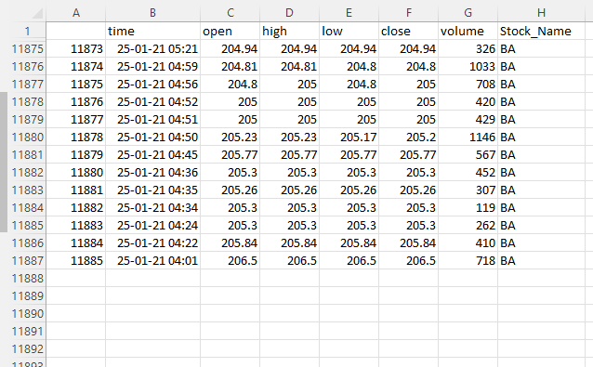
Scraping Historical Data
Stream data to influxdb
Current Process
Scraping Raw Data
Covert raw data to proper format
Combine data from each months

Slide 10

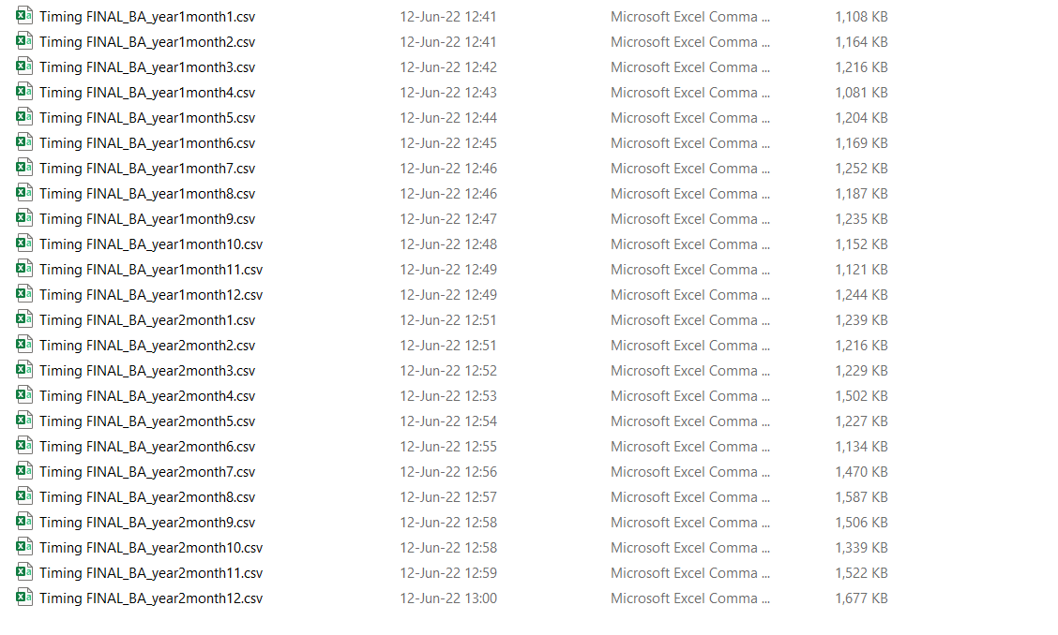
Scraping Historical Data
Stream data to influxdb
Current Process
Scraping Raw Data
Covert raw data to proper format
Combine data from each months
To merge file → Use window explorer to save every month of each stock into individual folder

Slide 11
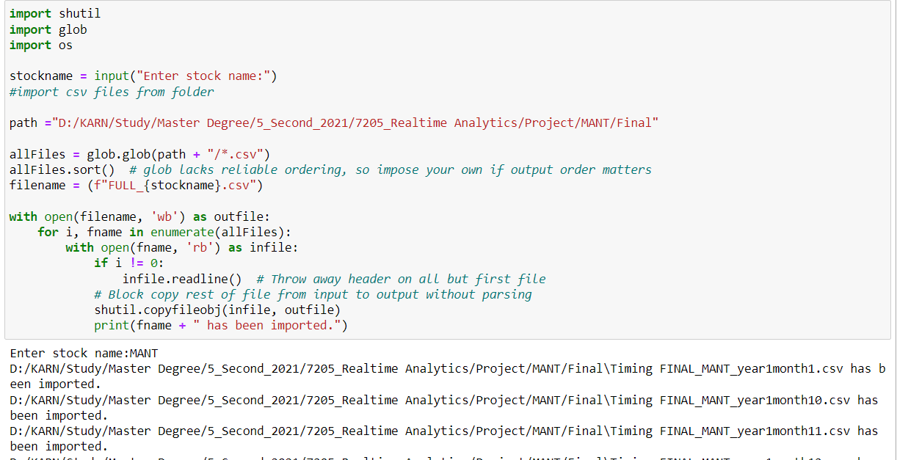
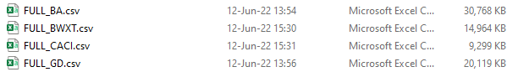
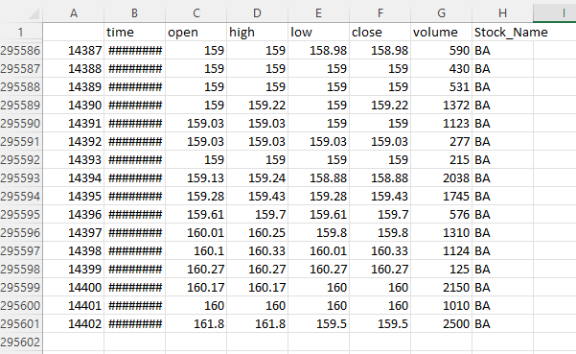
Scraping Historical Data
Stream data to influxdb
Current Process
Scraping Raw Data
Covert raw data to proper format
Combine data from each months

Slide 12
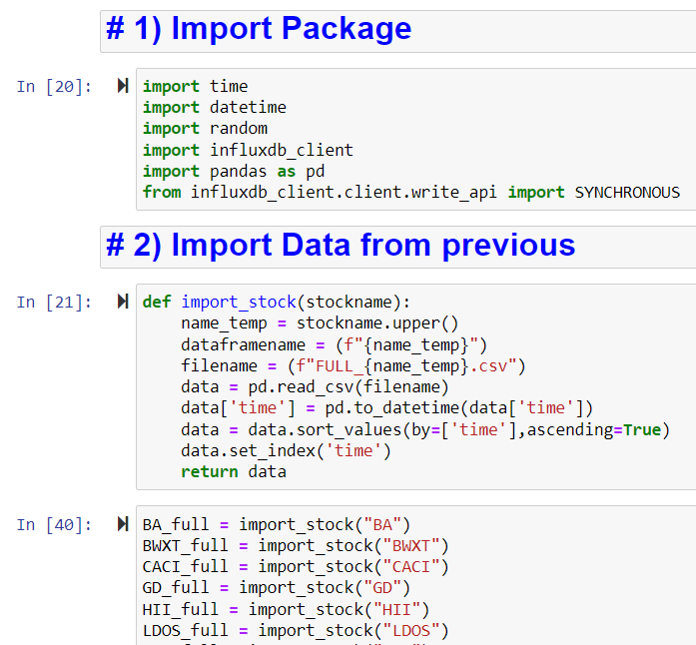
Scraping Historical Data
Stream data to influxdb
Current Process
Scraping Raw Data
Covert raw data to proper format
Combine data from each months

Slide 13
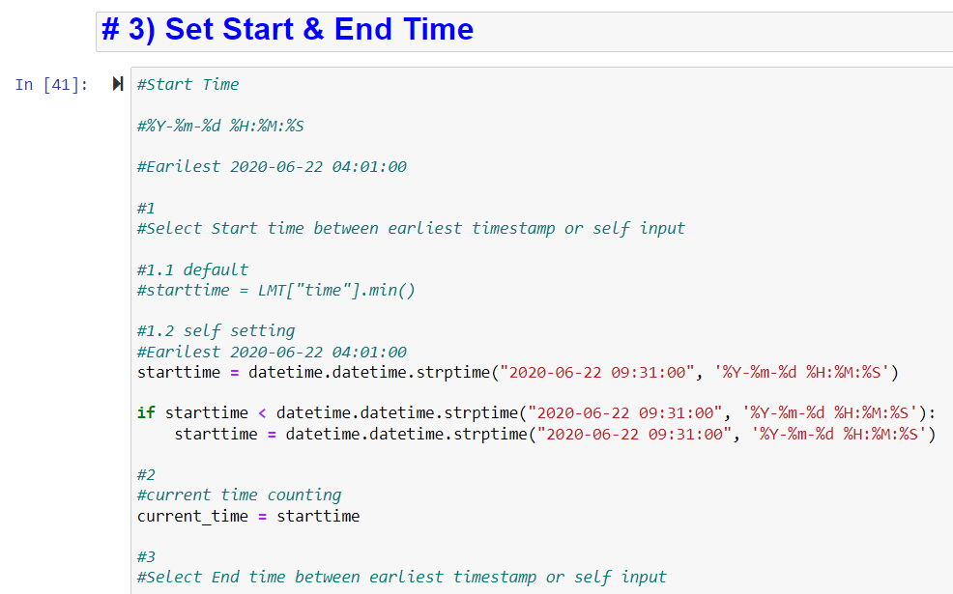
Scraping Historical Data
Stream data to influxdb
Current Process
Scraping Raw Data
Covert raw data to proper format
Combine data from each months

Slide 14

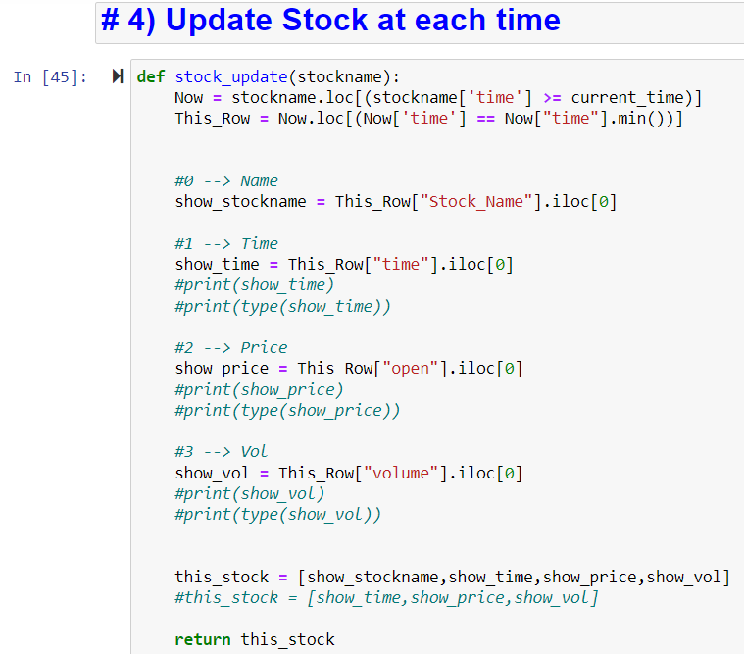
Scraping Historical Data
Stream data to influxdb
Current Process
Scraping Raw Data
Covert raw data to proper format
Combine data from each months

Slide 15
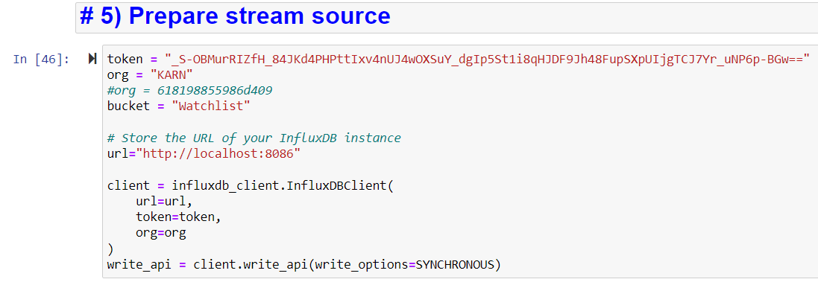
Scraping Historical Data
Stream data to influxdb
Current Process
Scraping Raw Data
Covert raw data to proper format
Combine data from each months

Slide 16
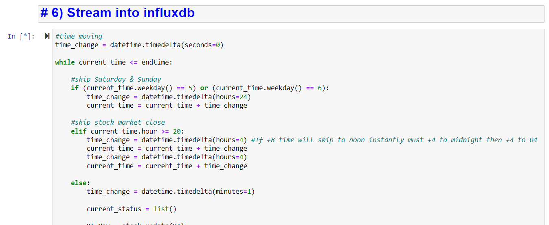
Scraping Historical Data
Stream data to influxdb
Current Process
Scraping Raw Data
Covert raw data to proper format
Combine data from each months

Slide 17
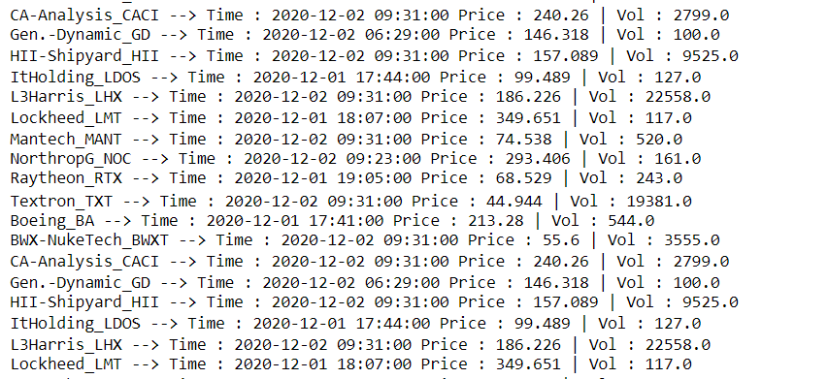
Scraping Historical Data
Stream data to influxdb
Current Process
Scraping Raw Data
Covert raw data to proper format
Combine data from each months

Slide 18

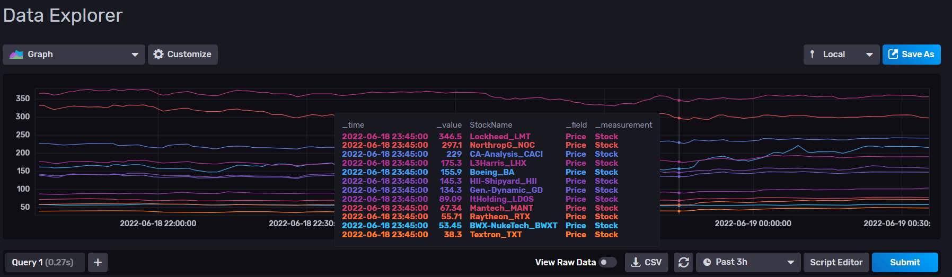
Scraping Historical Data
Stream data to influxdb
Current Process
Scraping Raw Data
Covert raw data to proper format
Combine data from each months
Time shown streaming not real transaction time

Slide 19
Result Summarized for full version
Stock API has limit per day incase of full version whether premium API or switch between each API provider must be used in order to run program all day
Can’t find how to upload more variable into influxdb, If not exist maybe need to change platform
Data of each stock are not big, Each stock 2 years data size just around 20 MB.
Maybe process can be done locally

